Slide 1
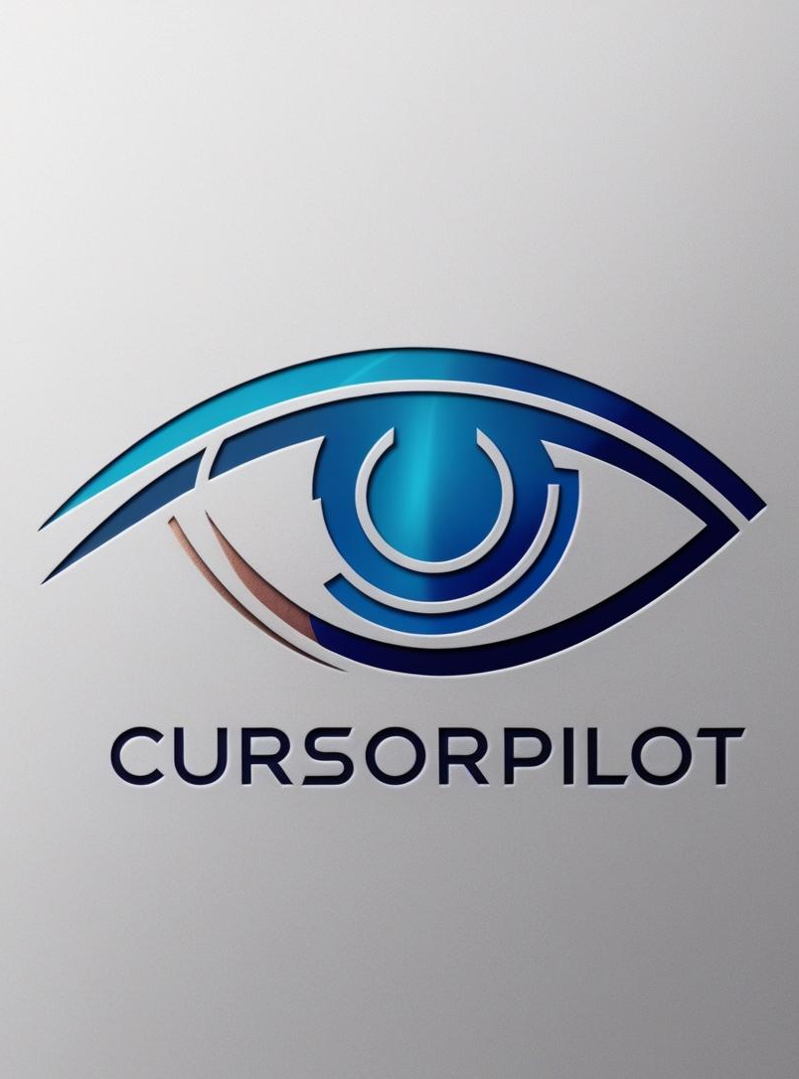

Eye-Based Cursor and Interaction Control System
Empowering hands-free digital interactions. A project to change computer interaction using head and eye movements. Designed for enhanced accessibility and seamless multitasking.
by Maanav Anand Kumar SBU ID: 116437327

Slide 2
Why This Project?
Current Challenges
My Goal
Traditional interaction methods require hands, limiting accessibility. Challenges faced include ergonomic strain and limited usability in hands-free scenarios.
Over 1 billion people globally live with some form of disability (WHO, 2023). Traditional input devices (e.g., mouse, keyboard) are often inaccessible for users with physical limitations.
Everyday Challenges and Multitasking: Professionals struggle to manage tasks with limited manual input.
Enable intuitive interaction with minimal physical effort and provide hands free navigation.
Meet the demand for Innovation: 89% of surveyed tech users believe gesture-based control could improve accessibility (Statista, 2022).

Slide 3
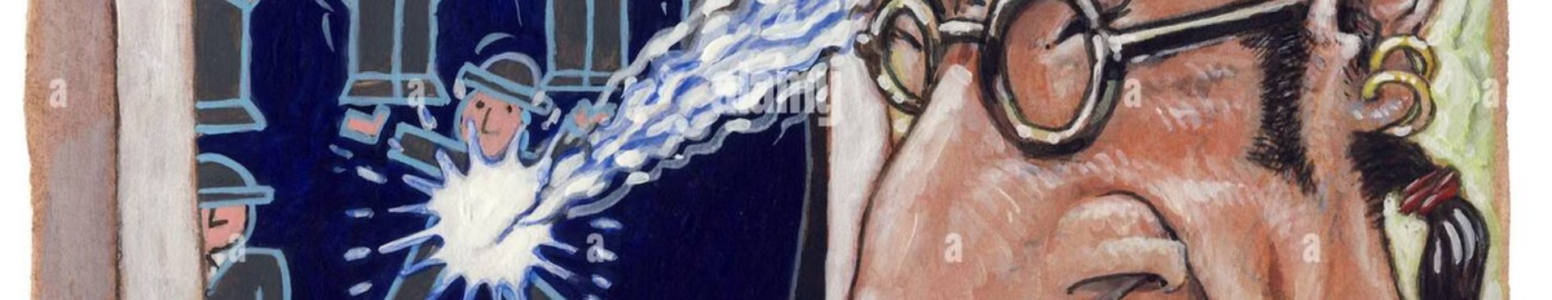
Core Functionalities
1
Eye-Controlled Cursor Movement
2
Scroll and Video Playback Control
Move the cursor effortlessly using gestures
of the eye and perform clicks using winks.
Use head tilts to scroll pages or control
video playback in fullscreen.

Slide 4
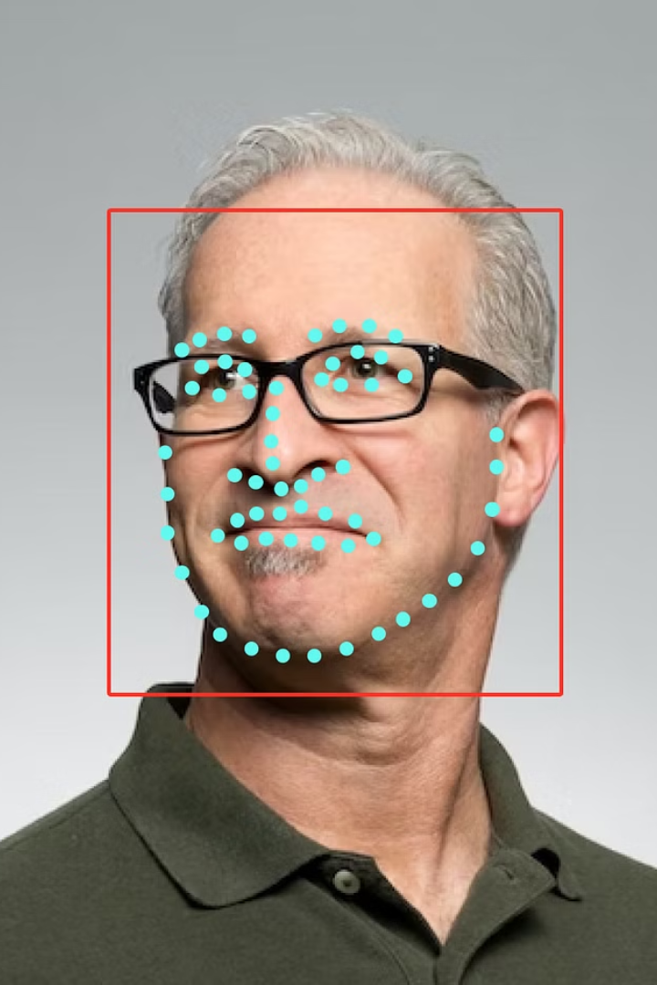



Technology Behind the System
Real-time image capture and tracking
using computer vision
Key technology: OpenCV
Maps face landmarks (eyes, nose, chin) to actions
like movement or tilting
Key technology: DLib
Translate the detected action into
changes on the system.
Key technology: PythonAutoGUI

Slide 5
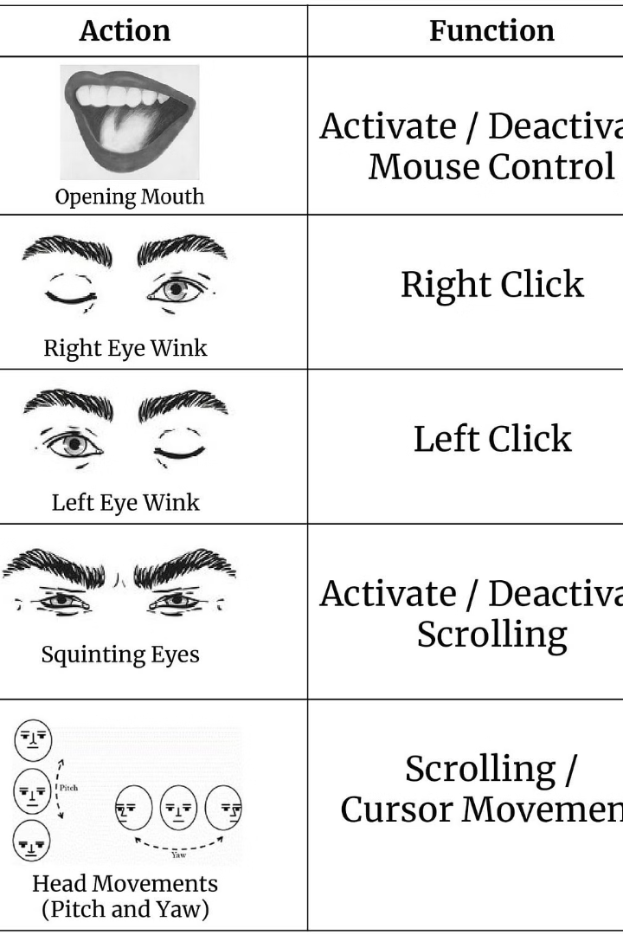
Switching Between Modes
Simple GUI
Modes
A simple, intuitive GUI enables mode selection and app control.
Cursor Movement
Scroll + Video Playback
Easy Control
Turn the app on or off with a single click or keyboard shortcuts

Slide 6
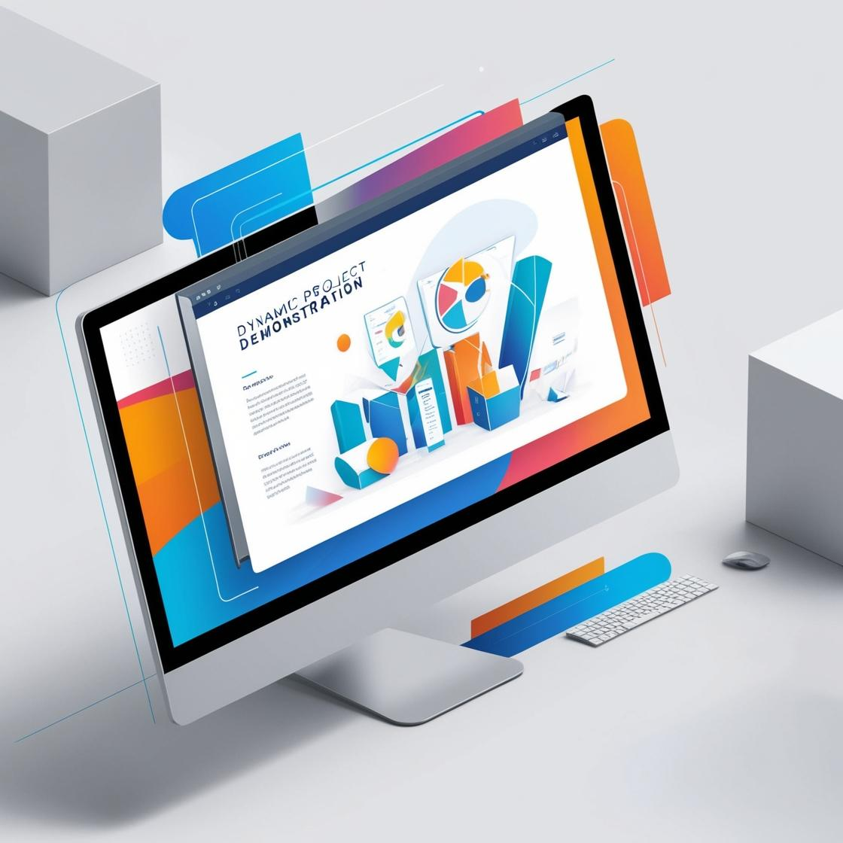
Real-Time Demo
Watch the system in action. See how the gestures translate into smooth, hands-free interactions.

Slide 7



Why It Matters
Enhances accessibility
Improves multitasking
Promotes ergonomic computing
For individuals with mobility limitations: Potential to empower over 200 million users with physical disabilities.
For professionals: Gesture-based solutions can save an average of 15% operational time in multitasking scenarios (McKinsey, 2023).
Reducing reliance on hands and increasing the user comfort directly translates to a happier and more productive environment .

Slide 8



The Road Ahead for Interaction Control
Taking intuitive, hands-free computing to a wider audience. Empowering users through accessibility and innovation.
1
Open-source community contributions
2
Improved adaptability for diverse users
3
Expanding functionalities

Slide 9
Thank you for your attention.
Maanav Anand Kumar SBU ID: 116437327

